Slide 1
Speaker Identification
Reporter:Zhao Guixiao
Notes:
实际上是对做的内容的定义做了精确。speaker recognition(说话人识别，也叫声纹识别)包含两个部分，一部分为speaker identification（说话人辨认），辨识出是哪一个说话人，属于多分类问题。另一部分为speaker verification（说话人确认），判断是不是这一个说话人，是二分类问题。

Slide 2
Traditional speaker identification
Deep Speaker Identification
Experiment

Slide 3
Traditional speaker identification
Traditional speaker identification methods generally include Vector quantization,Gaussian mixture model and Support Vector Machines.
Speaker identification method based on Gaussian mixture model generally include the following steps:Voice preprocessing,Feature extraction,Training model and Identification.
Notes:
传统的说话人识别方法包括：矢量量化、高斯混合模型、支持向量机，这里着重介绍基于高斯混合模型的说话人辨认方法。
基于高斯混合模型的说话人识别方法通常包括以下几个步骤：预处理、特征提取、训练模型、识别。

Slide 4
Voice preprocessing includes pre-emphasis, windowing and framing, and endpoint detection.
pre-emphasis is achieved using a first order finite response high pass filter that flattens the entire speech spectrum.
Notes:
预处理包括预加重、加窗和分帧、端点检测三个主要步骤。
预加重：采用一阶有限响应高通滤波器来实现，使得整个语音频谱变得平坦。

Slide 5
Windowing and framing: Using the short-term (10-30ms) stationary of the voice signal, framing is achieved by smoothing the sliding of the original speech signal with a movable finite length window.Window function generally chooses Hamming window.
Endpoint detection : find the starting and ending points of the speech segment, the commonly used method is based on the double threshold method of short-term energy and short-time zero-crossing rate.
Notes:
加窗和分帧：利用语音信号短时（10-30ms）平稳特性，分帧是利用一个可移动的有限长度的窗口在原始语音信号上平滑滑动进行加权来实现，窗函数一般选择汉明窗。
端点检测技术：找到语音段的起止点，常用的方法是基于短时能量和短时过零率的双门限法

Slide 6
Feature extraction: general extracted features are linear predictive cepstral coefficients and Mel cepstral coefficients.
Input voice
Pre-emphasis
FFT
Absolute value
Dynamic feature
DCT
Logarithm
Meyer filter
Output feature vector
Notes:
特征提取：通常提取的特征有线性倒谱系数和梅尔倒谱系数，但是梅尔倒谱系数的抗噪性能更好。

Slide 7
Training model: The initial value of the GMM parameter is obtained by K-means clustering, and the GMM parameters (weight, mean vector and covariance matrix) of the speaker are obtained by EM algorithm iteration.
The purpose of training is to achieve a speaker corresponding to a GMM.
Notes:
通过K均值聚类得到GMM参数的初始值，再通过EM算法迭代得到该说话人的GMM参数（权值，均值矢量和协方差矩阵）。
训练的目的为实现一个说话人对应一个GMM。

Slide 8
Identification: The similarity calculation is performed with the eigenvector of each frame of the test speaker and the GMM of each speaker obtained by training.calculate the maximum posterior probability, obtain the logarithmic score of each frame,take all frame scores and the highest score is the target speaker.
Notes:
用测试说话人的每一帧的特征矢量与训练得到的每个说话人的GMM进行相似度计算，计算最大后验概率，得到每一帧的对数得分，累加，取所有帧得分和，比较大小，分数最高则为该说话人。
P（λ_{n}|o）为该说话人是第n个人的后验概率（贝叶斯公式）。P（λ_{n}）是第n个人说话的先验概率。P（o）为所有说话人条件下产生特征矢量集o的概率。o为k维是声学特征矢量。由于每个人的P（λ_{n}）和P（o）都是相同的，化简得到下面的式子。转换为最大似然准则。

Slide 9
Result
Test speech feature vector set
Likelihood function calculation
Input voice
Pre-emphasis
Feature extraction
Training speech feature vector set
Model 1 (speaker 1)
Model 2(speaker 2)
K-means clustering
EM algorithm
Model n(speaker n)

Slide 10
Deep Speaker Identification
Deep Convolutional Network (CNN) is used for speech feature extraction and speaker identification.
Input: All voices are set to mono, 16-bit depth,16000 Hz sampling rate, using Hamming window, with a window length of 25ms, 10ms window shifting in the speech spectrum to obtain the spectorgarms (for 3s voice, generating 512*300 spectrograms).
It avoids the preprocessing of voice data and avoids losing valuable information.
Notes:
采用深度卷积网络（CNN）用以语音特征提取和说话人识别。
所有语音设置为单声道，16位深度，8000Hz采样率，采用汉明窗，以25ms的窗长，10ms的窗移在语音频谱滑动获得声谱（对3s的语音，产生512*300的声谱）。
规避了对语音数据的预处理，避免了可能丢失有价值的信息。

Slide 11
The network structure is based on VGG-M, and some modifications have been made on this basis.
a fully connected layer
dimension 9*1
fully connected fc6 layer
dimension 9*8
a average pool layer
dimension 1*n
Notes:
n由语音长度决定，以输入3s的语音长度为例，n=8.

Slide 12
input feature
speaker label
convolution1
softmax
max-pooling1
fully-connected7
convolution2
average-pooling6
max-pooling2
fully-connected6
convolution3
max-pooling5
convolution4
convolution5

Slide 13
Training strategy:The training is based on the deep learning toolkit MatConvNet. The training of the network uses a batch standardization method. The required parameters (weight, attenuation, learning rate) are provided by the toolkit. The beginning is to use softmax to pre-train the weight of the initial network to carry out multi-category training, and then fine-tune the model.
The trained spectrograms is mapped to a compact European space, and the distance metric is used to assess the similarity between speakers.
Notes:
训练基于深度学习工具包MatConvNet，网络的训练采用批量标准化的方法，所需参数（权重、衰减、学习率）都由工具包提供。开始是利用softmax进行预训练初始化网络的权重，也就是进行多分类训练，然后对模型进行微调。
训练好的语音频谱会映射到一紧凑的欧式空间，距离度量用来评估说话人之间的相似性。

Slide 14
Identification: Due to the existence of the average pooling layer (apool6) in the network, the network is allowed to input voices of different lengths during the test.
By changing the size of the average pooling layer (dimention: 1*n), the entire test voice can be evaluated at one time. The traditional approach is to integrate speech into the same length as input.
Output: The output is the score of the speech of and the label information of the corresponding speaker.
Notes:
由于平均池化层apool6的存在，在测试阶段允许输入不同长度的语音。
通过改变平均池化层(dimention:1*n)的大小，可以一次评估整段测试语音。而传统的方法是将语音整合成相同的长度作为输入。
输出为该段语音的得分和对应说话人的标签信息。

Slide 15
Experiment
Five people's audio data was obtained by recording, set to 16 kHz sampling rate, 16-bit depth, mono.
The experiment was performed twice, and the speech was first divided into arbitrary lengths (10-20s per segment) for testing.
The second time divides the speech into 3s per segment. Test the accuracy of identification at shorter lengths.
Notes:
通过录音获得五个人的音频数据，设置为16kHz采样率，16位深度，单声道。
实验进行了两次，第一次将语音分割为任意长度（10-20s每段）进行测试。
第二次将语音分割为3s每段。测试较短长度下识别的准确率。

Slide 16
Speaker | Length(s) | Number | Correct Number | Correct Rate(%)
Speaker1 | any | 18 | 16 | 89
Speaker2 | any | 18 | 18 | 100
Speaker3 | any | 17 | 9 | 52
Speaker4 | any | 15 | 9 | 60
Speaker5 | any | 20 | 13 | 65
Average | any | 17.6 | 13 | 73.2

Slide 17
Speaker | Length(s) | Number | Correct Number | Correct Rate(%)
Speaker1 | 3 | 40 | 23 | 57.5
Speaker2 | 3 | 40 | 21 | 52.5
Speaker3 | 3 | 34 | 12 | 35.2
Speaker4 | 3 | 30 | 15 | 50
Speaker5 | 3 | 39 | 23 | 58.9
Average | 3 | 36.6 | 18.8 | 50.82

Slide 18
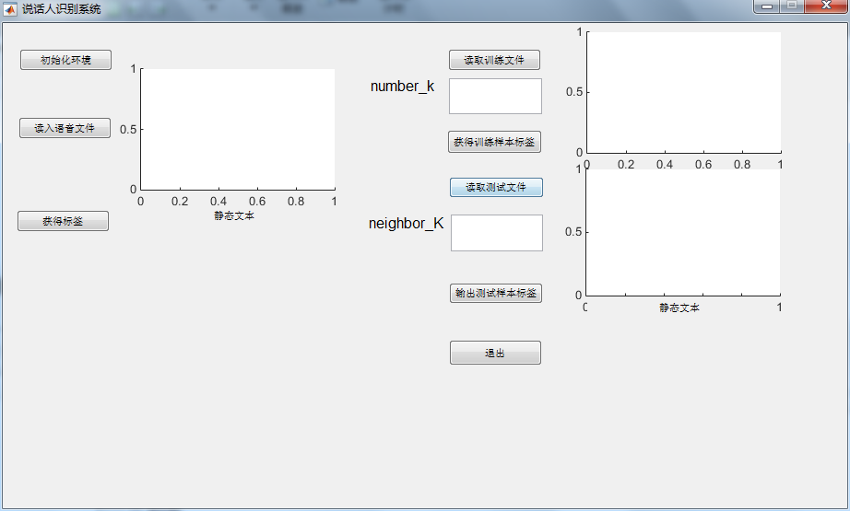

Slide 19
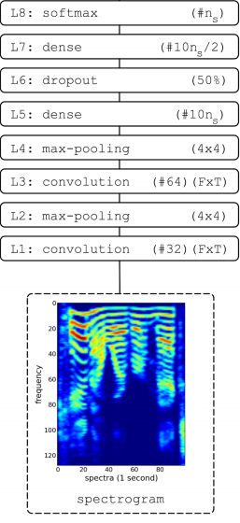
Input:Using a spectrogram as an input to the CNN network.
Network structure:Each convolutional layer is followed by a max-pooling layer.
To prevent overfitting, a dropout layer was added between the dense layers with a dropout rate of 0.5 .
Use linear units as activation functions for all layers.
Notes:
相较于前面介绍的网络，该网络层数更少，但是网络结构大同小异。
该网络也是利用声谱图作为整个网络的输入。规避了对语音进行预处理的过程，避免了丢失有效信息。
每一个卷积层后都有一个最大池化层，为了预防过拟合，加入了下采样层，将采样率为0.5。
采用线性单元作为所有层的激活函数。常用的线性激活函数由relu

Slide 20
Training strategy:The network is trained using minibatch gradientdescent (batch size 128) with Nesterov momentum, usingcross-entropy as the loss function.
Output:Use the softmax layer as the output of the network
Notes:
训练策略：使用具有牛顿动量（是momentum的变种，优化过程中用到的一个参数）的小批量梯度下降（批量大小128）训练网络，使用交叉熵作为损失函数。
输出：采用softmax层作为整个网络的输出，其中ns就是用于辨认的所有的说话人的数目。

Slide 21
Thank You

